Slide 1
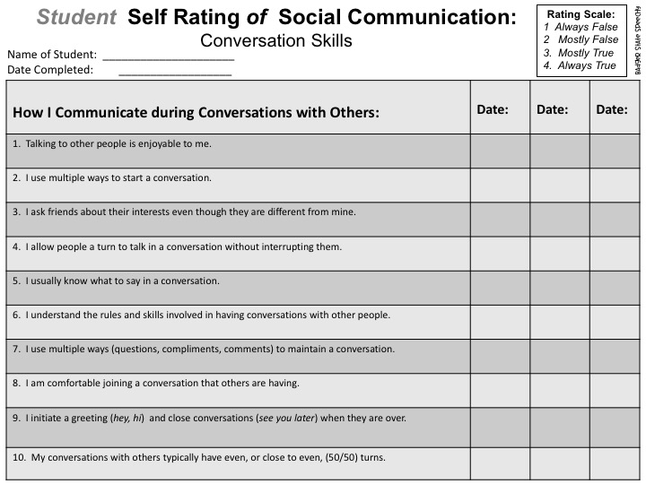
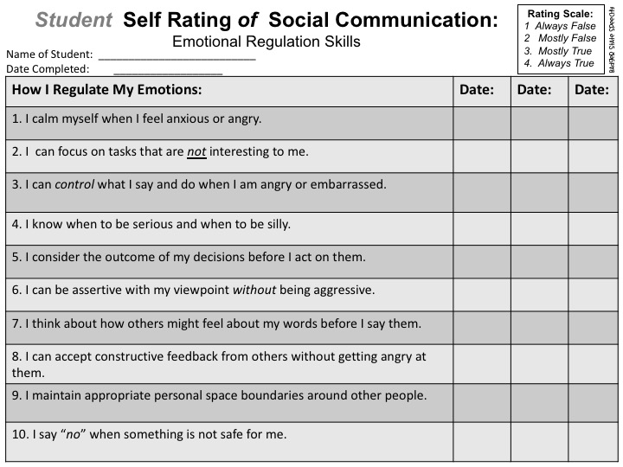
Self-rating & Teacher-rating
of
Social Communication Skills!
Online
or
Hard Copies!
Editable PowerPoint!
by
Middle & High School

Slide 4
Seven Editable
Rating Scales & report templates
Conversation Skills
Friendship Skills
Emotional Regulation Skills
Nonverbal Communication Skills
Understanding Perspectives
and Social Cues
Study Skills and
Organization, and
Blank Editable Template
Badger State Speechy

Slide 5
Avoiding Bias with Self-ratings:
Rating scales come with a risk of bias. There are several things that have been or can be done to reduce bias in these scales:
These ratings are on a 4-point scale. There is no midpoint to eliminate the neutral option from the rating scale to avoid respondents hovering all responses at midpoint and hopefully, increase respondent effort.
I’ve tried to word the questions to avoid leading the respondents to the “positive” or “correct” answer. Since it is editable, you can also edit the questions. The wording on the student ratings may vary slightly from the teacher/parent wording on the same scale.
Do the student self-rating 1:1 with the student. Why? You can support their understanding of the questions and probe them to provide evidence for their self-ratings. Doing self-ratings with groups of students may cause the student to provide the socially acceptable answer rather than being truthful.
Before you begin, remind the student there are no right or wrong answers.
Some students may lack introspective ability and may not be able to assess themselves accurately. This could account for student ratings that differ significantly from parent/teacher ratings.
Badger State Speechy

Slide 6
How to Make Self-assessment Meaningful!
1. Have the parent, teacher or SLP perform observations of the student across settings, if possible, as they are completing the assessment.
2. Review of self assessment measures with a student are best done in 1:1 situations to reduce social bias. Reviewing it in a group may lead to the student inflating the ratings or not feeling comfortable with being honest and reflective.
3. After the student performs their self-rating, review the answers with the student. Ask for “evidence” or examples that support the student’s self-ratings. Having them support their answers can facilitate more honest responses.
4. Have an adult (parent, teacher, or slp) videotape the student in a social setting. Review the videotape with the student and refer to the student’s self-ratings.
*Are they accurate?
*Does the student want to change his/her ratings?
5. Compare the ratings from the teacher/parent/slp to the student’s self-ratings. Discuss ratings that are 2-3 points apart or ratings that you feel are not be an accurate reflection of the skills of the student.
*What settings does the adult see the student in (social, school etc.)?
*What might account for the differences in ratings between the adult and the student? Student perception? Observation opportunities? Other?
Re-administer the scale(s) to monitor progress across therapy or assessment cycles.
The information from the rating scales can be added to evaluations and reports using the templates included.
Individualize the rating scales to the needs of your students or workplace. They are all editable in PowerPoint!
Badger State Speechy

Slide 7
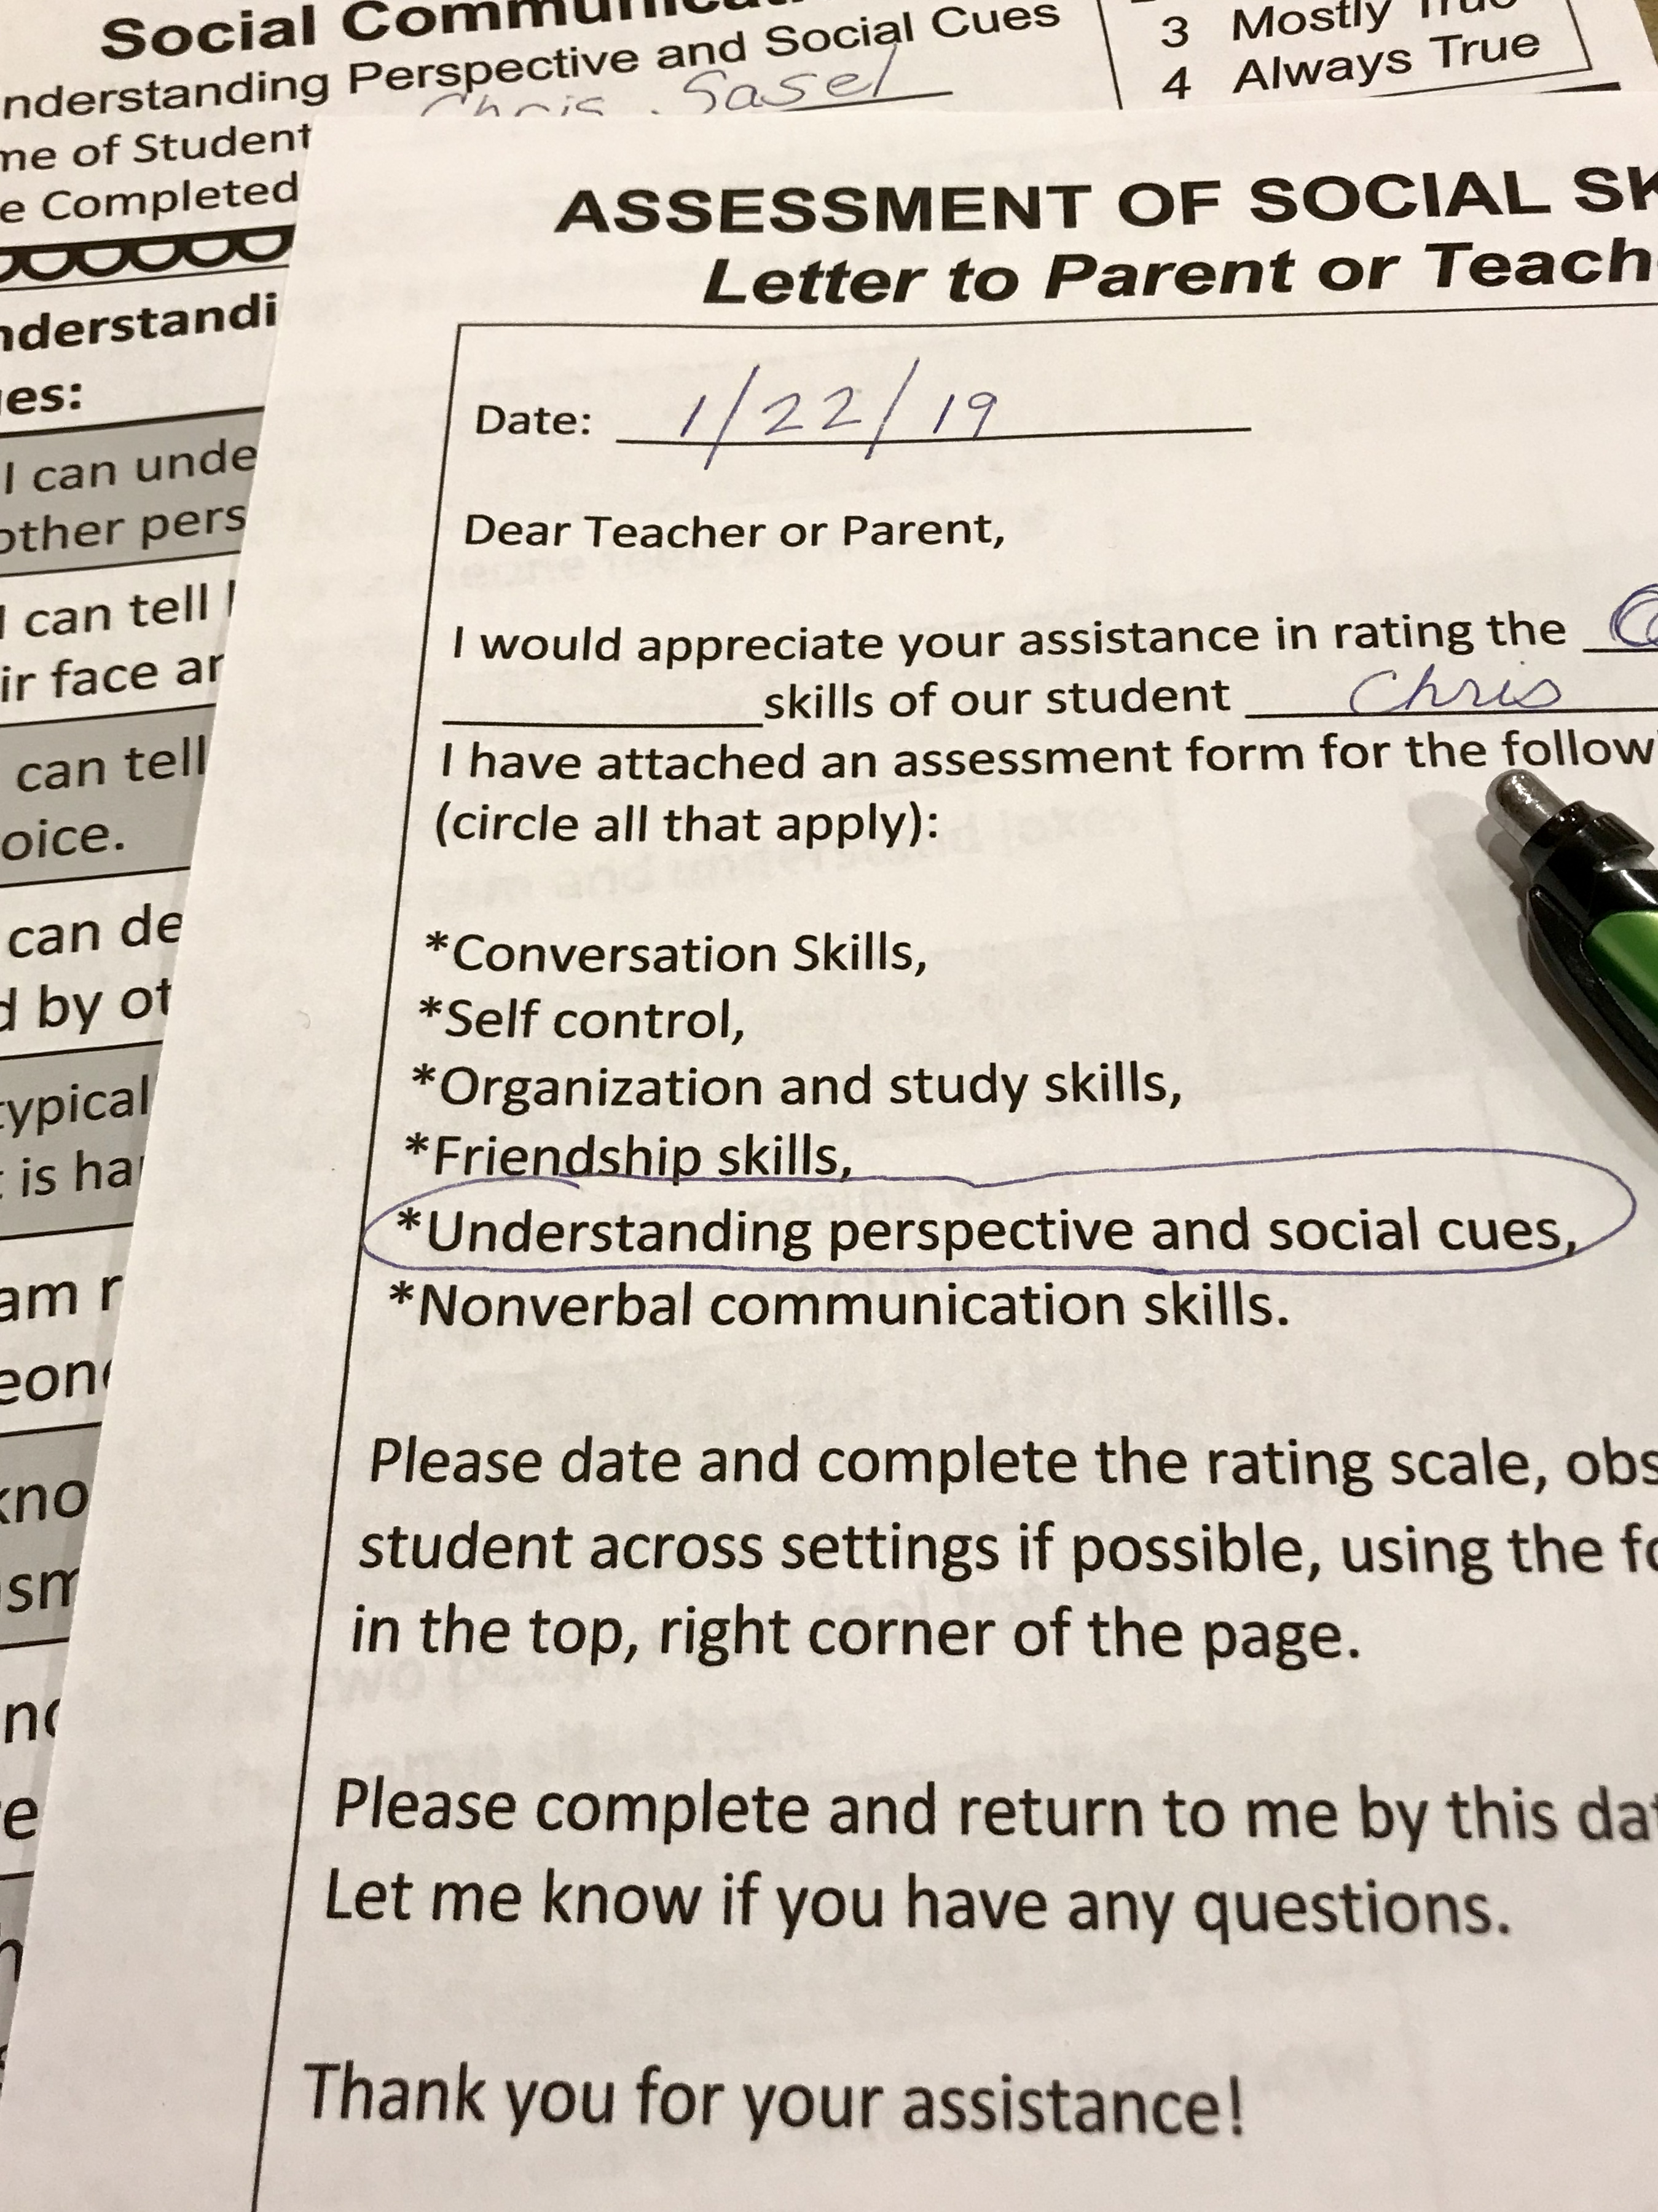
Hard Copy Version in use!
Badger State Speechy

Slide 8
Goals and Instructions:
Teletherapy Administration
Objectives:
1) for student and adult to assess various aspects related to social communication, including:
emotional regulation, conversation, perspective-taking and understanding social cues, use of nonverbal communication skills, study skills and organization, and friendship skills.
2) to compare the ratings between the self-assessment done by the student and the ratings done by the familiar adult.
3) to increase student’s self-awareness of his/her social skills.
Instructions for Online Administration (teletherapy)
1. Choose which rating scales you want to use with your student. There are six choices and a template, and all are editable.
2. Student Rating themselves: Either you or the student can add the date and the student’s rating in the box. You can also use it online with a teletherapy platform that has screen-sharing and digital annotation. Be sure to discuss each individual skill and rating. It is important to make sure the student understands the statements and accurately reflects upon their own skills.
3. Parent/teacher/SLP Rating Student: Send the rating scale(s) instructions and selected rating scale(s) to the parent or teacher that is completing it. Here’s how I do it:
Copy and paste the “letter to parent or teacher” (using the form that says “online completion” at the top) into an email and modify it to your needs. Then, attach the selected rating scale(s) to the email. Other options for online completion and return are on the following page.
Badger State Speechy

Slide 9
Methods for Online Completion of Rating Scale(s):
Parent/teacher completion
Parents and teachers can complete the rating
scales, depending upon their access to technology.
1. Ask parents if they have PowerPoint or adobe acrobat with the “fill and sign” function, a scanner, or even access to a fax machine.
a) If they have PowerPoint, insert the slides from the PowerPoint into a new PowerPoint document
that you would like them to complete. Also include the parent/teacher instructions page. Email the PowerPoint to the parent as an attachment. Have them complete the ratings and email it back to you!
b) If they have an adobe acrobat version with the “fill and sign,” function, follow step a. Then, save the
document as a pdf. Email the pdf to the parent/teacher as an attachment and have them complete the ratings, save it and email it back to you.
c) Scanner or Fax? Save the select pages as a pdf. Send to raters with instructions. Have rater scan it and return to you via email or fax it to you.
d) No adobe, PowerPoint, fax or scanner? No problem. Save the selected pages of the PowerPoint as a pdf. Email it to the parent/teacher as an attachment. Have raters take a close-up photo of the completed page(s) and email or text it to you.
e) You can have the parent/teacher email their ratings to you within an email or do it online during a ZOOM (or other platform) session with the parent/teacher.
Badger State Speechy

Slide 10
ASSESSMENT OF SOCIAL SKILLS:
Editable Letter to Parent or Teacher
(Online Completion) Insert into email
Date:
Dear Teacher or Parent,
I would appreciate your assistance in rating these social skills and/or areas that potentially impact social skills, of my/our student (student’s name). I have attached an assessment form for the following skills (include all that apply):
*Conversation Skills,
*Emotional Regulation,
*Organization and study skills,
*Friendship skills,
*Understanding perspective and social cues,
*Nonverbal communication skills.
Please date and complete the rating scale, observing the student across settings if possible and choose the best rating using the four-point rating scale in the top, right corner of the page.
Please complete and return to me by this date: (insert date)
(Include instructions for method of completion and return, (read methods for online completion page for ideas).
Thank you for your assistance!
(your name)
attachment(s)

Slide 11
Goals and Instructions:
Using Hard Copies
Objectives:
1) for student and adult to assess various aspects related to social communication, including:
emotional regulation, conversation, perspective-taking and understanding social cues, use of nonverbal communication skills, study skills and organization, and friendship skills.
2) to compare the ratings between the self-assessment done by the student and the ratings done by the familiar adult.
3) to increase student’s self-awareness of his/her social skills.
Instructions for Administration:
1. Choose which rating scales you want to use with your student. There are six choices and a
blank template and all are editable!
2. Print the rating scale(s) instructions letter, (use the one on the following page, not the online
completion form) and write in the necessary information on the form.
3. Student: Do not give the student the rating scale for independent completion. It is
important that you make sure the student understands each statement and self-reflects upon their skills.
4. Parent/teacher: Print the selected rating scale(s) and give/send the instructions and
rating scale(s) to the parent or teacher that is completing it. Have them be sure to let you know if they have any questions about the statements, they are rating. Encourage them to email you or write down any additional comments.
Badger State Speechy

Slide 12
Student Rating Scale(s)
Date: __________________
Dear __________________________,
I would appreciate your assistance in rating the _______________________skills of our student _________________________.
I have attached an assessment form for the following social skills (or areas that potentially impact social skills). (circle all that apply):
*Conversation skills,
*Emotional regulation,
*Organization and study skills,
*Friendship skills,
*Understanding perspective and social cues,
*Nonverbal communication skills.
Please date and complete the rating scale, observing the student across settings if possible, using the four-point rating scale in the top, right corner of the page.
Please complete and return to me by this date: _____________.
Let me know if you have any questions.
Thank you for your assistance!
______________________________________

Slide 13
Social Skills Student
Self-Rating Scales and Templates:
For student
All Editable in PowerPoint
Conversation Skills,
Friendship Skills,
Understanding Perspective and Social Cues,
Emotional Regulation,
Nonverbal Communication Skills,
Organization and Study Skills,
Blank template: individualize.
Badger State Speechy

Slide 14
Student Self Rating of Social Communication:
Conversation Skills
Rating Scale:
1 Always False 2 Mostly False
3. Mostly True
4. Always True
Badger State Speechy
Name of Student: _____________________
Date Completed: __________________
How I Communicate during Conversations with Others: | Date: | Date: | Date:
1. Talking to other people is enjoyable to me.
2. I use multiple ways to start a conversation.
3. I ask friends about their interests when they are different from mine.
4. I make sure people get a turn to talk in a conversation without interrupting them.
5. I usually know what to say in a conversation.
6. I understand the rules and skills involved in having conversations with other people.
7. I use multiple ways (questions, compliments, comments) to maintain a conversation.
8. I am comfortable joining a conversation that others are having.
9. I initiate a greeting (hey, hi) and close conversations (see you later) when they are over.
10. My conversations with others typically have even, or close to even, (50/50) turns.

Slide 15
Student Self Rating of Social Communication:
Friendship Skills
Rating Scale:
1 Always False 2 Mostly False
3. Mostly True
4. Always True
Badger State Speechy
Name of Student: _____________________
Date Completed: __________________
How I Make and Keep Friends: | Date: | Date: | Date:
1. I make and keep friends.
2. I am happy with the number of friends that I have.
3. I resolve conflicts with other people.
4. I compromise when I have a disagreement with someone.
5. I apologize when I hurt someone’s feelings.
6. I am a good sport when I lose a game.
7. I understand what makes a good friendship.
8. Other people show interest in being friends with me.
9. I am happy for my friends when they succeed.
10. I show interest (smile, nod) when my friends are talking to me.

Slide 16
Student Self Rating of Social Communication:
Understanding Perspectives and Social Cues:
Rating Scale:
1 Always False 2 Mostly False
3. Mostly True
4. Always True
Badger State Speechy
Name of Student: _____________________
Date Completed: __________________
How I Understand Perspectives and Social Cues from Others: | Date: | Date: | Date:
1. I understand what another person might think or feel.
2. I can tell how someone feels by watching their face and body.
3. I can identify how someone feels by listening to their tone of voice.
4. I detect sarcasm and understand jokes made by others.
5. I understand and interpret what is happening in social situations.
6. I notice when someone is being deceitful or “tricking” me.
7. I know when it’s okay and not okay to use sarcasm.
8. I think that two people can feel totally different about the same situation.
9. I change my behavior based on how others are responding to my words and actions.
10. I think about what I say and how I act and consider how my words and actions are viewed by others.

Slide 17
Student Self Rating of Social Communication:
Emotional Regulation Skills
Rating Scale:
1 Always False 2 Mostly False
3. Mostly True
4. Always True
Badger State Speechy
Name of Student: __________________________
Date Completed: __________________
How I Regulate My Emotions: | Date: | Date: | Date:
1. I calm myself when I feel anxious or angry.
2. I can focus on tasks that are not interesting to me.
3. I can control what I say and do when I am angry or embarrassed.
4. I know when to be serious and when to be silly.
5. I consider the outcome of my decisions before I act on them.
6. I can be assertive with my viewpoint without being aggressive.
7. I think about how others might feel about my words before I say them.
8. I can accept constructive feedback from others without getting angry at them.
9. I maintain appropriate personal space boundaries around other people.
10. I say “no” when something is not safe for me.

Slide 18
Student Self Rating of Social Communication:
Nonverbal Communication Skills
Rating Scale:
1 Always False 2 Mostly False
3. Mostly True
4. Always True
Badger State Speechy
Name of Student: _____________________
Date Completed: __________________
How I Use Nonverbal Communication: | Date: | Date: | Date:
1. I look at others when I talk with them.
2. I use appropriate loudness of my voice in all settings.
3. I easily change my tone of voice to communicate different feelings.
4. I sit or stand up straight and face others when I am talking to them.
5. I maintain an appropriate distance to others when I talk with them.
6. My facial expressions and body language match what I am saying.
7. I shake someone’s hand if it is offered.
8. I use sarcasm only in appropriate and/or informal situations.
9. I don’t use inappropriate facial expressions (eye rolling, smirking) in formal (school/work) situations.
10. My clothing and appearance are appropriate for work/school situations.

Slide 19
Student Self Rating of Social Communication:
Organization and Study Skills
Rating Scale:
1 Always False 2 Mostly False
3. Mostly True
4. Always True
Badger State Speechy
Name of Student: _____________________
Date Completed: __________________
How I Keep Organized and Study for School: | Date: | Date: | Date:
1. I wait for all directions before starting an assignment.
2. I complete school assignments by their due dates.
3. My home study area is neat and organized.
4. I routinely review and discard old papers or files, so they don’t build up.
5. I have a place for my things and know where they are when I need them.
6. I ask questions when I do not understand an assignment.
7. I manage my time effectively.
8. I have a system for keeping track of important dates and tests.
9. I have all the supplies I need to complete assignments.
10. I keep a general schedule that I follow each day and week.

Slide 20
Student Self Rating of Social Communication:
Rating Scale:
1 Always False 2 Mostly False
3. Mostly True
4. Always True
Badger State Speechy
Name of Student: _____________________
Date Completed: __________________
How I : | Date: | Date: | Date:
1.
2.
3.
4.
5.
6.
7.
8.
9.
10.

Slide 21
Template for reporting responses from
“conversation skills” scale
Copy and Paste:
On a student self-rating scale, student rated themselves on a rating scale of conversation skills on a four-point scale with 1 being always false, 2 being mostly false, 3 being mostly true and 4 being always true. Student rated themselves as follows:
1 always false:
2 mostly false:
3 mostly true:
4 always true:
Student
Self Rating
Copy and paste the probes into the 1-4 based on student’s results.
1. Talking to other people is enjoyable to me.
2. I use multiple ways to start a conversation.
3. I ask friends about their interests when they are different from mine.
4. I make sure people get a turn to talk in a conversation without interrupting them.
5. I usually know what to say in a conversation.
6. I understand the rules and skills involved in having conversations with other people.
7. I use multiple ways (questions, compliments, comments) to maintain a conversation.
8. I am comfortable joining a conversation that others are having.
9. I initiate a greeting (hey, hi) and close conversations (see you later) when they are over.
10. My conversations with others typically have even, or close to even, (50/50) turns.
Badger State Speechy

Slide 22
Template for reporting responses from
“friendship skills” scale
Copy and Paste:
On a student self-rating scale, student rated themselves on a rating scale of friendship skills, on a scale of 1-4 with 1 being always false, 2 being mostly false, 3 being mostly true and 4 being always true. Student rated themselves as follows:
1 always false:
2 mostly false:
3 mostly true:
4 always true:
Student
Self Rating
Copy and paste the probes into the 1-4 based on student’s results.
1. I make and keep friends.
2. I am happy with the number of friends that I have.
3. I resolve conflicts with other people.
4. I compromise when I have a disagreement with someone.
5. I apologize when I hurt a friend’s feelings.
6. I am a good sport when I lose a game.
7. I understand what makes a good friendship.
8. Other people show interest in being friends with me.
9. I am happy for my friends when they succeed.
10. I show interest (smile, nod) when my friends are talking to me.
Badger State Speechy

Slide 23
Template for reporting responses from
“understanding perspectives and social cues” scale
Copy and Paste:
On a student self-rating scale, student rated themselves on a rating scale of understanding perspectives and social cues, on a scale of 1-4 with 1 being always false, 2 being mostly false, 3 being mostly true and 4 being always true. Student rated themselves as follows:
1 always false:
2 mostly false:
3 mostly true:
4 always true:
Student
Self Rating
Copy and paste the probes into the 1-4 based on student’s results.
1. I understand what another person might think or feel.
2. I can tell how someone feels by watching their face and body.
3. I can identify how someone feels by listening to their tone of voice.
4. I detect sarcasm and understand jokes made by others.
5. I understand and interpret what is happening in social situations.
6. I notice when someone is being deceitful or “tricking” me.
7. I know when it’s okay and not okay to use sarcasm.
8. I think that two people can feel totally different about the same situation.
9. I change my behavior based on how others are responding to my words and actions.
10. I think about what I say and how I act and consider how my words and actions are viewed by others.
Badger State Speechy

Slide 24
Template for reporting responses from
“emotional regulation skills” scale
Copy and Paste:
On a student self-rating scale, student rated themselves on a rating scale emotional regulation skills, on a scale of 1-4 with 1 being always false, 2 being mostly false, 3 being mostly true and 4 being always true. Student rated themselves as follows:
1 always false:
2 mostly false:
3 mostly true:
4 always true:
Student
Self Rating
Copy and paste the probes into the 1-4 based on student’s results.
1. I calm myself when I feel anxious or angry.
2. I can focus on tasks that are not interesting to me.
3. I can control what I say and do when I am angry or embarrassed.
4. I know when to be serious and when to be silly.
5. I consider the outcome of my decisions before I act on them.
6. I can be assertive with my viewpoint without being aggressive.
7. I think about how others might feel about my words before I say them.
8. I can accept constructive feedback from others without getting angry at them.
9. I maintain appropriate personal space boundaries around other people.
10. I say “no” when something is not safe for me.
Badger State Speechy

Slide 25
Template for reporting responses from
“expression of nonverbal communication skills” scale
Copy and Paste:
On a student self-rating scale, student rated themselves on a rating scale of expression of nonverbal communication skills, on a scale of 1-4 with 1 being always false, 2 being mostly false, 3 being mostly true and 4 being always true. Student rated themselves as follows:
1 always false:
2 mostly false:
3 mostly true:
4 always true:
Student Self
Rating
Copy and paste the probes into the 1-4 based on student’s results.
1. I look at others when I talk with them.
2. I use appropriate loudness of my voice in all settings.
3. I easily change my tone of voice to communicate different feelings.
4. I sit or stand up straight and face others when I am talking to them.
5. I maintain an appropriate distance to others when I talk with them.
6. My facial expressions and body language match what I am saying.
7. I shake someone’s hand if it is offered.
8. I use sarcasm only in appropriate and/or informal situations.
9. I don’t use inappropriate facial expressions (eye rolling, smirking) in formal (school/work) situations.
10. My clothing and appearance are appropriate for work/school situations.
Badger State Speechy

Slide 26
Template for reporting responses from
“organization and study skills” scale
Copy and Paste:
On a student self-rating scale, student rated themselves on a rating scale of organization and study skills, on a scale of 1-4 with 1 being always false, 2 being mostly false, 3 being mostly true and 4 being always true. Student rated themselves as follows:
1 always false:
2 mostly false:
3 mostly true:
4 always true:
Student Self
Rating
Copy and paste the probes into the 1-4 based on student’s results.
1. I wait for all directions before starting an assignment.
2. I complete school assignments by their due dates.
3. My home study area is neat and organized.
4. I routinely review and discard old papers or files, so they don’t build up.
5. I have a place for my things and know where they are when I need them.
6. I ask questions when I do not understand an assignment.
7. I manage my time effectively.
8. I have a system for keeping track of important dates and tests.
9. I have all the supplies I need to complete assignments.
10. I keep a general schedule that I follow each day and week.
Badger State Speechy

Slide 27
Social Skills Rating Scales and Templates:
For Parent, SLP or Teacher
All Editable in PowerPoint
Conversation Skills,
Friendship Skills,
Understanding Perspectives and Social Cues,
Emotional Regulation,
Nonverbal Communication Skills,
Organization and Study Skills,
Blank template: individualize.
Badger State Speechy

Slide 28
Rating of Social Communication:
Conversation Skills
Rating Scale:
1 Always False 2 Mostly False
3. Mostly True
4. Always True
Badger State Speechy
Name of Student: _____________________
Date Completed: __________________ Rater’s Name: _________________________
How Student Communicates during Conversations with Others: | Date: | Date: | Date:
1. Talking to other people seems enjoyable to the student.
2. Student uses multiple ways to start conversations with others.
3. Student asks friends about their interests even though they are different from those of the student.
4. Student allows people a turn to talk in a conversation without interrupting them.
5. Student knows what to say in a conversation.
6. Student seems to understand the rules & skills involved in having conversations with other people.
7. Student uses multiple ways (questions, compliments, comments) to maintain conversations.
8. Student seems comfortable joining an existing conversation that others are having.
9. Student initiates greetings and closes conversations (see you later) with other people.
10. Student’s conversations with others typically have an even, or close to even, (50/50) number of turns.

Slide 29
Rating of Social Communication:
Friendship Skills
Rating Scale:
1 Always False 2 Mostly False
3. Mostly True
4. Always True
Badger State Speechy
Name of Student: _____________________
Date Completed: __________________ Rater’s Name: _________________________
How Student Makes and Keeps Friends: | Date: | Date: | Date:
1. Student seems adept at making and keeping friends.
2. Student seems comfortable with the number of friends they have.
3. Student is successful at resolving conflicts with friends.
4. Student compromises when they have a disagreement with others.
5. Student apologizes when they hurt someone’s feelings.
6. Student is a good sport when they lose a game.
7. Student seems to understand how to be a good friend.
8. Other people show interest in being friends with the student.
9. Student seems happy for others when they succeed.
10. Student shows interest (smiles, nods) when friends are talking to them.

Slide 30
Rating of Social Communication:
Understanding Perspectives and Social Cues:
Rating Scale:
1 Always False 2 Mostly False
3. Mostly True
4. Always True
Badger State Speechy
Name of Student: _____________________
Date Completed: __________________ Rater’s Name: _________________________
How Student Understands Perspectives & Social Cues from Others: | Date: | Date: | Date:
1. Student seems to easily understand the perspective of another person.
2. Student seems to be able to tell how someone feels by watching their face and body.
3. Student can easily identify how someone feels by listening to their tone of voice.
4. Student seems to easily detect sarcasm and understand jokes made by others.
5. Student understands and correctly interprets what is happening in social situations.
6. Student understand when someone is being deceitful or “tricking” them.
7. Student knows when it’s okay and not okay to use sarcasm.
8. Student knows and accepts that two people can feel totally different about the same situation.
9. Student changes behavior based on how others are responding to their words and actions.
10. Student appears to consider how their words and actions are perceived by others.

Slide 31
Rating of Social Communication:
Emotional Regulation Skills
Rating Scale:
1 Always False 2 Mostly False
3. Mostly True
4. Always True
Badger State Speechy
Name of Student: _____________________
Date Completed: __________________ Rater’s Name: _________________________
How Student Regulates their Emotions: | Date: | Date: | Date:
1. Student calms themselves when they feel anxious or angry.
2. Student focuses on tasks that are not interesting to them.
3. Student controls what they say and do when angry or embarrassed.
4. Student is serious and/or silly in appropriate situations.
5. Student considers the outcome of decisions before acting on them.
6. Student can be assertive with their viewpoint without being aggressive.
7. Student thinks about how others might feel about their words before saying them.
8. Student accepts constructive feedback from others without getting angry.
9. Student maintains appropriate personal space boundaries around other people.
10. Student can say “no” when something is unsafe for them.

Slide 32
Rating of Social Communication:
Nonverbal Communication Skills
Rating Scale:
1 Always False 2 Mostly False
3. Mostly True
4. Always True
Badger State Speechy
Name of Student: _____________________
Date Completed: __________________ Rater’s Name: _________________________
How Student Uses Nonverbal Communication: | Date: | Date: | Date:
1. Student looks at others when talking with them.
2. Student uses appropriate volume in all settings.
3. Student changes tone of voice to communicate different feelings.
4. Student sits or stands up straight and face others when talking to them.
5. Student maintains appropriate distance from others while talking with them.
6. Student’s facial expressions and body language match what they are saying.
7. Student shakes someone’s hand if it is offered.
8. Student uses sarcasm only in appropriate and/or informal situations.
9. Student uses appropriate facial expressions (no eye rolling, smirking) in formal (school/work) situations.
10. Student’s clothing & appearance are appropriate for school/work.

Slide 33
Rating of Social Communication:
Organization and Study Skills
Rating Scale:
1 Always False 2 Mostly False
3. Mostly True
4. Always True
Badger State Speechy
Name of Student: _____________________
Date Completed: __________________ Rater’s Name: _________________________
How Student Keeps Organized and Studies for/at School: | Date: | Date: | Date:
1. Student waits for all directions before starting an assignment
2. Student completes school assignments by their due dates.
3. Student’s home study area is neat and organized.
4. Student routinely reviews & discards old papers/files, so they don’t build up.
5. Student has a place for things and can find them when needed.
6. Student asks questions when not understanding an assignment.
7. Student manages time wisely and effectively.
8. Student has a system for keeping track of important dates and tests.
9. Student typically has all the supplies needed to complete assignments.
10. Student keeps a general schedule that is followed each day and week.

Slide 34
Rating of Social Communication:
Rating Scale:
1 Always False 2 Mostly False
3. Mostly True
4. Always True
Badger State Speechy
Name of Student: _____________________
Date Completed: __________________ Rater’s Name: _________________________
How Student : | Date: | Date: | Date:
1.
2.
3.
4.
5.
6.
7.
8.
9.
10.

Slide 35
Template for reporting responses from
“conversation skills” scale
Copy and Paste:
On a teacher or parent rating scale, _____________________ (name and relationship) rated student on a rating scale of conversation skills, on a scale of 1-4 with 1 being always false, 2 being mostly false, 3 being mostly true and 4 being always true. ______________ rated student as follows:
1 always false:
2 mostly false:
3 mostly true:
4 always true:
Parent or
Teacher Rating
Copy and paste the probes into the 1-4 based on parent or teacher’s ratings.
1. Talking to other people seems enjoyable to the student.
2. Student uses multiple ways to start conversations with others.
3. Student asks friends about their interests even though they are different from those of the student.
4. Student allows people a turn to talk in a conversation without interrupting them.
5. Student usually knows what to say in a conversation.
6. Student seems to understand the rules & skills involved in having conversations with other people.
7. Student uses multiple ways (questions, compliments, comments) to maintain conversations.
8. Student seems comfortable joining an existing conversation that others are having.
9. Student initiates greetings and closes conversations (see you later) with other people.
10. Student’s conversations with others typically have an even, or close to even, (50/50) number of turns.
Badger State Speechy

Slide 36
Template for reporting responses from
“friendship skills” scale
Copy and Paste:
On a teacher or parent rating scale, _____________________ (name and relationship) rated student on a rating scale of friendship skills, on a scale of 1-4 with 1 being always false, 2 being mostly false, 3 being mostly true and 4 being always true. ______________ rated student as follows:
1 always false:
2 mostly false:
3 mostly true:
4 always true:
Parent or
Teacher Rating
Copy and paste the probes into the 1-4 based on parent or teacher’s ratings.
1. Student seems adept at making and keeping friends.
2. Student seems comfortable with the number of friends they have.
3. Student is successful at resolving conflicts with friends.
4. Student compromises when they have a disagreement with others.
5. Student apologizes when they hurt a friend’s feelings.
6. Student is a good sport when they lose a game.
7. Student seems to understand how to be a good friend.
8. Other people show interest in being friends with the student.
9. Student seems happy for others when they succeed.
10. Student shows interest (smiles, nods) when friends are talking to them.
Badger State Speechy

Slide 37
Template for reporting responses from
“understanding perspectives and social cues” scale
Copy and Paste:
On a teacher or parent rating scale, _____________________ (name and relationship) rated student on a rating scale of understanding perspectives and social cues, on a scale of 1-4 with 1 being always false, 2 being mostly false, 3 being mostly true and 4 being always true. ______________ rated student as follows:
1 always false:
2 mostly false:
3 mostly true:
4 always true:
Parent or
Teacher Rating
Copy and paste the probes into the 1-4 based on parent or teacher’s ratings.
1. Student seems to easily understand the perspective of another person.
2. Student seems to be able to tell how someone feels by watching their face and body.
3. Student can easily identify how someone feels by listening to their tone of voice.
4. Student seems to easily detect sarcasm and understand jokes made by others.
5. Student understands and correctly interprets what is happening in social situations.
6. Student understand when someone is being deceitful or “tricking” them.
7. Student knows when it’s okay and not okay to use sarcasm.
8. Student knows and accepts that two people can feel totally different about the same situation.
9. Student changes behavior based on how others are responding to their words and actions.
10. Student appears to consider how their words and actions are perceived by others.
Badger State Speechy

Slide 38
Template for reporting responses from
“emotional regulation skills” scale
Copy and Paste:
On a teacher or parent rating scale, _____________________ (name and relationship) rated student on a rating scale of emotional regulation skills, on a scale of 1-4 with 1 being always false, 2 being mostly false, 3 being mostly true and 4 being always true. ______________ rated student as follows:
1 always false:
2 mostly false:
3 mostly true:
4 always true:
Parent or
Teacher Rating
Copy and paste the probes into the 1-4 based on parent or teacher’s ratings.
1. Student calms themselves when they feel anxious or angry.
2. Student focuses on tasks that are not interesting to them.
3. Student controls what they say and do when angry or embarrassed.
4. Student is serious and/or silly in appropriate situations.
5. Student considers the outcome of decisions before acting on them.
6. Student can be assertive with their viewpoint without being aggressive.
7. Student thinks about how others might feel about their words before saying them.
8. Student accepts constructive feedback from others without getting angry.
9. Student maintains appropriate personal space boundaries around other people.
10. Student can say “no” when something is unsafe for them.
Badger State Speechy

Slide 39
Parent or
Teacher Rating
Template for Reporting responses from
“expression of nonverbal communication skills” scale
Copy and Paste:
On a teacher or parent rating scale, _____________________ (name and relationship) rated student on a rating scale of expression of nonverbal communication skills, on a scale of 1-4 with 1 being always false, 2 being mostly false, 3 being mostly true and 4 being always true. ______________ rated student as follows:
1 always false:
2 mostly false:
3 mostly true:
4 always true:
Copy and paste the probes into the 1-4 based on parent or teacher’s ratings. 1. Student looks at others when talking with them.
2. Student uses appropriate volume in all settings.
3. Student changes tone of voice to communicate different feelings.
4. Student sits or stands up straight and face others when talking to them.
5. Student maintains appropriate distance from others while talking with them.
6. Student’s facial expressions and body language match what they are saying.
7. Student shakes someone’s hand if it is offered.
8. Student uses sarcasm only in appropriate and/or informal situations.
9. Student uses appropriate facial expressions (no eye rolling, smirking) in formal (school/work) situations.
10. Student’s clothing & appearance are appropriate for school/work.
Badger State Speechy

Slide 40
Template for reporting responses from
“organization and study skills” scale
Copy and Paste:
On a teacher or parent rating scale, _____________________ (name and relationship) rated student on a rating scale of organization and study skills, on a scale of 1-4 with 1 being always false, 2 being mostly false, 3 being mostly true and 4 being always true. ______________ rated student as follows:
1 always false:
2 mostly false:
3 mostly true:
4 always true:
Parent or
Teacher Rating
Copy and paste the probes into the 1-4 based on parent or teacher’s ratings.
1. Student waits for all directions before starting an assignment
2. Student completes school assignments by their due dates.
3. Student’s home study area is neat and organized.
4. Student routinely reviews & discards old papers/files, so they don’t build up.
5. Student has a place for things and can find them when needed.
6. Student asks questions when not understanding an assignment.
7. Student manages time wisely and effectively.
8. Student has a system for keeping track of important dates and tests.
9. Student typically has all the supplies needed to complete assignments.
10. Student keeps a general schedule that is followed each day and week.
Badger State Speechy

Slide 41
Reporting responses where both student
and teacher were each given the same scale(s)
Copy and Paste:
Add one or more of these statement(s) after you have summarized each rater’s responses:
Student rated themselves higher/lower in these areas than the teacher/slp/parent did
in the following areas: (list)
and/or
There were significant/minor discrepancies in the student’s rating of themselves compared
to the teacher/slp/parent in the following areas: (list)
and/or
These areas were rated within one point of each other by the student and the teacher/slp/parent: (list)
Badger State Speechy

